Slide 1
Text to Speech Synthesis using Speaker Adaptation
Using end to end Deep Learning Model
Team Members: RITIKA MUGUNDAN 183002133
SHWETHA S 183002155
SAINITHYA S 183002140
VIGNESH V 183002182
SRIRAM R 183002164

Slide 2
Review II

Slide 3
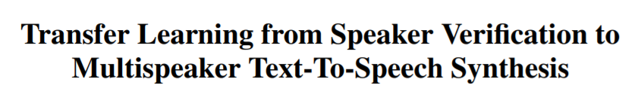
Problem Statement
We use a neural network-based system for text-to-speech (TTS) synthesis that is able to generate speech audio in the voice of different speakers, including those unseen during training.
We then adapt the network for a single speaker dataset.
Based on :

Slide 4
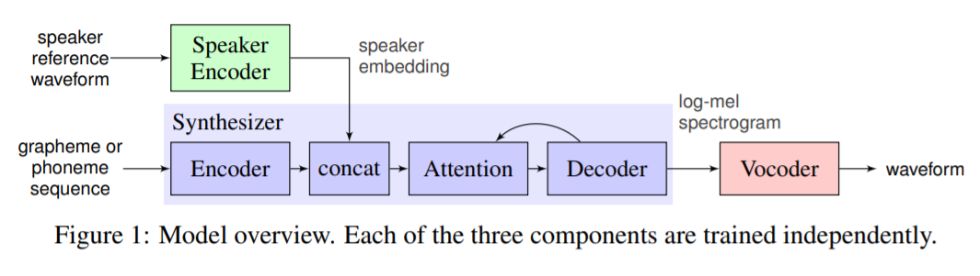
What we are working on

Slide 5
Synthesizer
It predicts a mel spectrogram from a sequence of grapheme or phoneme inputs using Tacotron 2 architecture
An embedding vector for the target speaker is concatenated with the synthesizer encoder output at each time step.
The synthesizer is trained on pairs of text transcript and target audio.
At the input, we map the text to a sequence of phonemes, which leads to faster convergence and improved pronunciation of rare words and proper nouns.
The network is trained in a transfer learning configuration, using a pre-trained speaker encoder (whose parameters are frozen) to extract a speaker embedding from the target audio, i.e. the speaker reference signal is the same as the target speech during training.

Slide 6
Experimental setup of the Pre-trained Synthesizer
LibriSpeech is a corpus of read speech, based on LibriVox's public domain audiobooks.
The encoder, synthesizer and vocoder were pre-trained on the train-clean-100 corpus, which consists of 100 hours of clean speech from around 250 speakers.
The encoder, synthesizer and vocoder were pre-trained on the Librispeech - train-clean-100 corpus, which consists of 100 hours of clean speech from around 250 speakers.
The training details are mentioned for each sub-network below
Encoder: trained 1.56M steps (20 days with a single GPU) with a batch size of 64
Synthesizer: trained 278k steps (1 week with 4 GPUs) with a batch size of 144
Vocoder: trained 428k steps (4 days with a single GPU) with a batch size of 100

Slide 7
Broad Overview of First Review
Preprocessed 13 mins of single speaker data from Librispeech Dataset
Fine-tuned the synthesizer on data for 2000 iterations
Tested results
(Data was not recorded for first review)

Slide 8
Our task
Second Review
1st expt : synthesizer trained on noisy data.
2nd expt: synthesizer trained on noiseless data
The fine tuning process for the speaker adaptation task is elaborated below.
The same steps are followed for the second set of experiments ( Experiments for second review)
We load the pretrained weights from the github repo.(https://github.com/CorentinJ/Real-Time-Voice-Cloning)
(details about the pretrained network are mentioned in the previous slide)
We load our network with these weights.
For all our experiments, we are only training the synthesizer. Therefore we make use of synthesizer_preprocess_audio.py, synthesizer_preprocess_embeds.py to preprocess our data. (Recorded by Ritika)
We then train the synthesizerusing synthezier_train.py
For testing we use the demo_toolbox.py file, where the original weights of the encoder and vocoder are used and the “fine tuned” synthesizer weights are used.

Slide 9

Testing
Before and after Fine tuning
No one would have believed in the last years of the nineteenth century that this world was being watched keenly and closely
No one would have believed in the last years of the nineteenth century / that this world was being watched keenly and closely

Slide 10
Inference from Review I
Deficiencies with the synthesizer and its pretrained model can be compensated to some extent, by fine-tuning to a single speaker. This is much easier than implementing a new synthesizer and requires far less training.
A small dataset of 0.2 hours is sufficient for fine-tuning the synthesizer.
Better single-speaker performance can be obtained with just a few thousand steps of additional synthesizer training.

Slide 11
Workflow for Second Review
Recorded audio for single speaker (Ritika) for 8 mins
Noise removed from utterances
Created transcripts for each utterance
Preprocessed the data generated
Fine-tuned the synthesizer on the data
Tested the results

Slide 12
Testing
Text - Open the crate but don’t break the glass
Before fine-tuning
After fine-tuning

Slide 13
Testing
Text - No one would have believed in the last years of the nineteenth century that this world was being watched keenly and closely
Before fine-tuning
After fine-tuning

Slide 14
Testing intelligibility with SUS
The place closed the fish that lived
A1: Today's close the fish that lived
A2: The place closed the fish that lived
A3: Please close the fish tank lid
A4: The place closed the fish that lived
A5: The place close the fish that lives
A6: The priest closed the fish that lived
A7: Please close the fish that lived

Slide 15
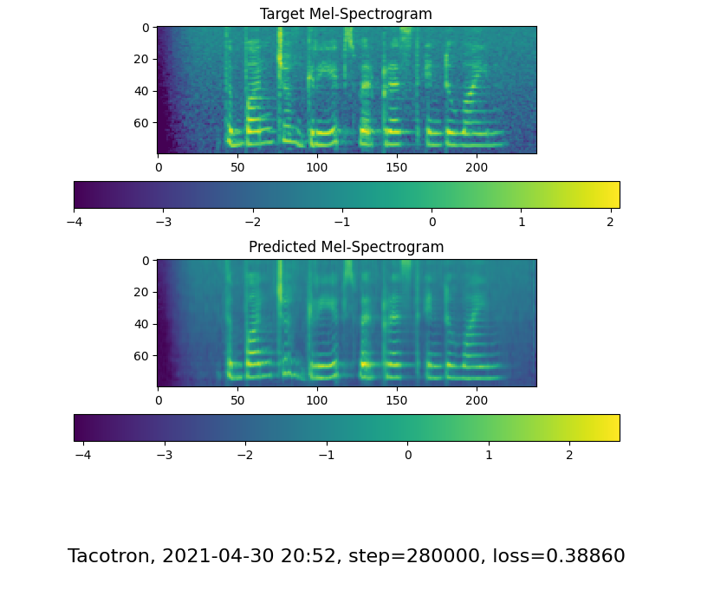
Mel Spectrogram
This is the mel spectrogram that we obtain at the last step of training on the noiseless data.
The predicted spectrogram is smoothed in comparison to the target Spectrogram.
The predicted Mel Spectrogram will improve with more training.

Slide 16
Inferences
The fine tuned model (trained on our own dataset) models the prosody of the speaker better.
The original model synthesizes speech that has an North American accent.
In contrast, the fine tuned model which is trained for just 2000 steps synthesizes speech that resembles the Indian accent.
4. The speaker rate is also more similar to Ritika’s speaker rate.
5. Training the synthesizer on noisy data leads to a noisy wav file.
6. Training the synthesizer on the noise removed data leads to much better results and more natural speech.

Slide 17
Evaluating Performance (1) - MOS
We recorded an utterance of a sentence and also synthesized the same with synthesizer before and after fine-tuning.
We then asked 20 people to listen to the samples and score the quality on a scale (1-5)

Slide 18
Mean Opinion Score
5 - Excellent
4 - Good
3 - Fair
2 - Poor
1 - Bad
Recorded utterance | Utterance synthesized before fine-tuning | Utterance synthesized after fine-tuning
4.55 | 3.7 | 3.9

Slide 19
Evaluating Performance (2)
- ABX Test
We recorded utterances of 5 sentences and also synthesized the same with the synthesizer before and after fine-tuning.

Slide 20
We then asked 20 people to listen to the samples and answer which of the 2 synthesized utterances sounded more like the recorded utterance.
X - Recorded utterance
A , B - Synthesized utterance

Slide 21
When asked which of the two synthesized sentences more closely resembled recorded utterance:
Percentage of times speech synthesized before fine-tuning was picked | Percentage of times speech synthesized after fine-tuning was picked
15 | 85

Slide 22
THANK YOU

